Slide 1
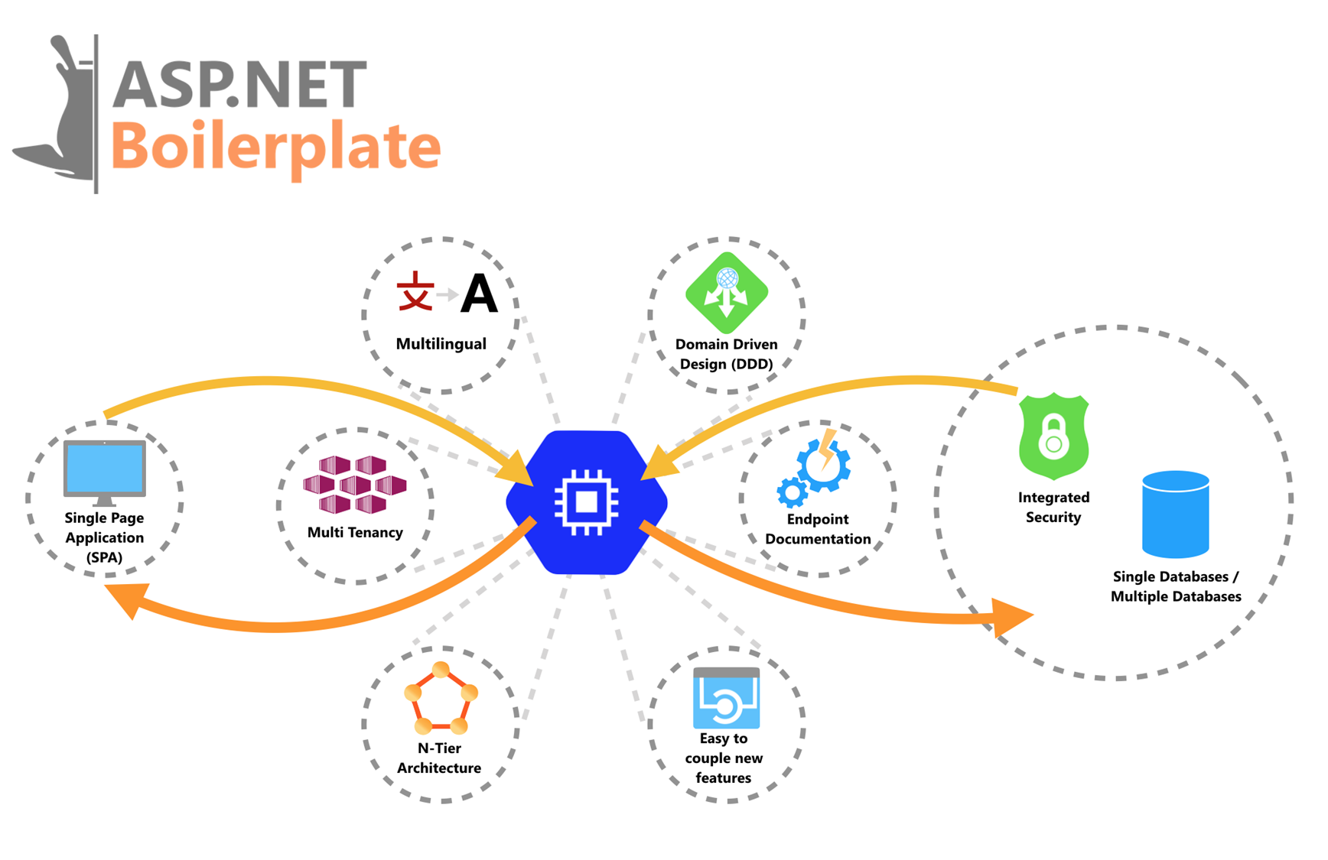
ASP.NET Boilerplate Fundamental
A STRONG INFRASTRUCTURE FOR MODERN WEB APPLICATIONS

Slide 2
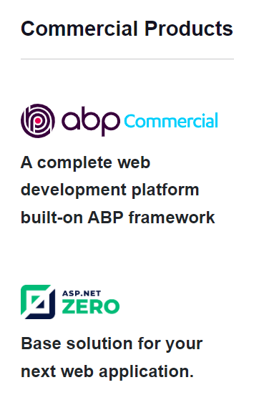
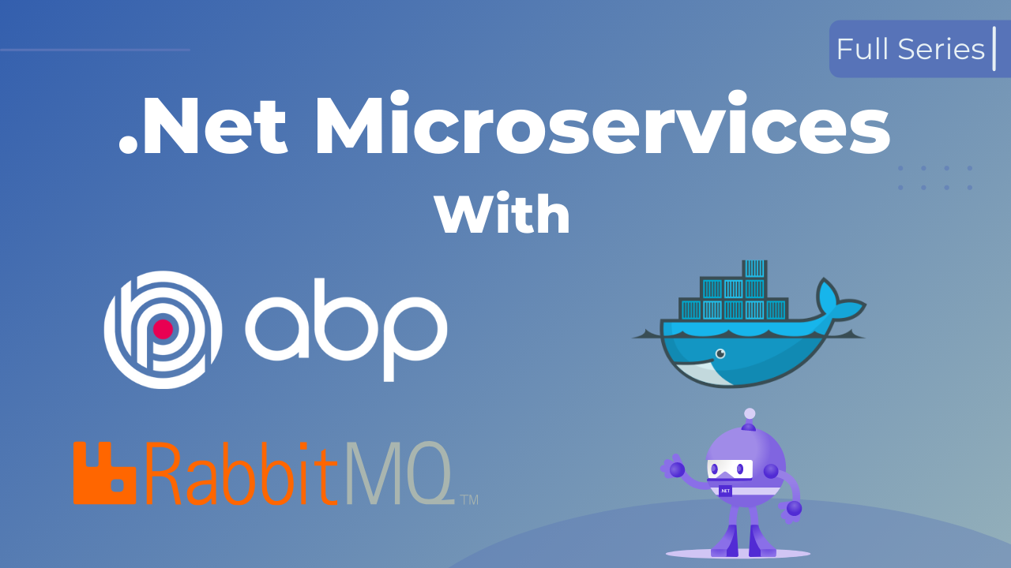
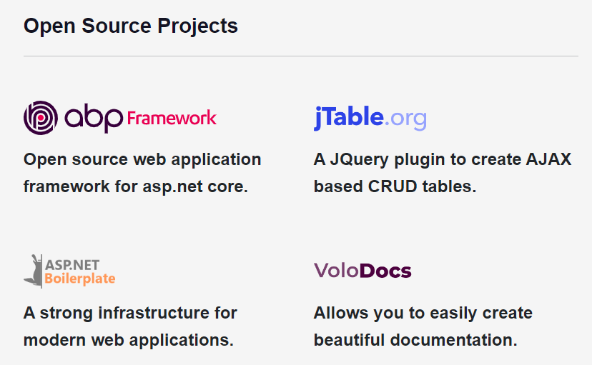
ASP.NET Boilerplate
About contributors – Volosoft.com
With team is mainly experienced on:
Microsoft technologies: ASP.NET Core, Typescript…
Common JavaScript frameworks: Angular, React, Vue…
Database: SQL Server, MySQL, MongoDB, PostgreSQL…
Mobile development: React Native, Xamarin
A proud sponsor of the .NET Foundation
ABP Framework is a complete infrastructure to create modern web applications

Slide 3
ASP.NET Boilerplate
Prerequirements
Java Stack
LAMP Stack
Nodejs Stack
Following tools should be installed:
Visual Studio 2017 or latest
Database
Visual Studio Extensions: Bundler & Minifier, Web Compiler
Stack knowledge:
Front-end stack
DotNet Stack
Mobile Stack

Slide 4
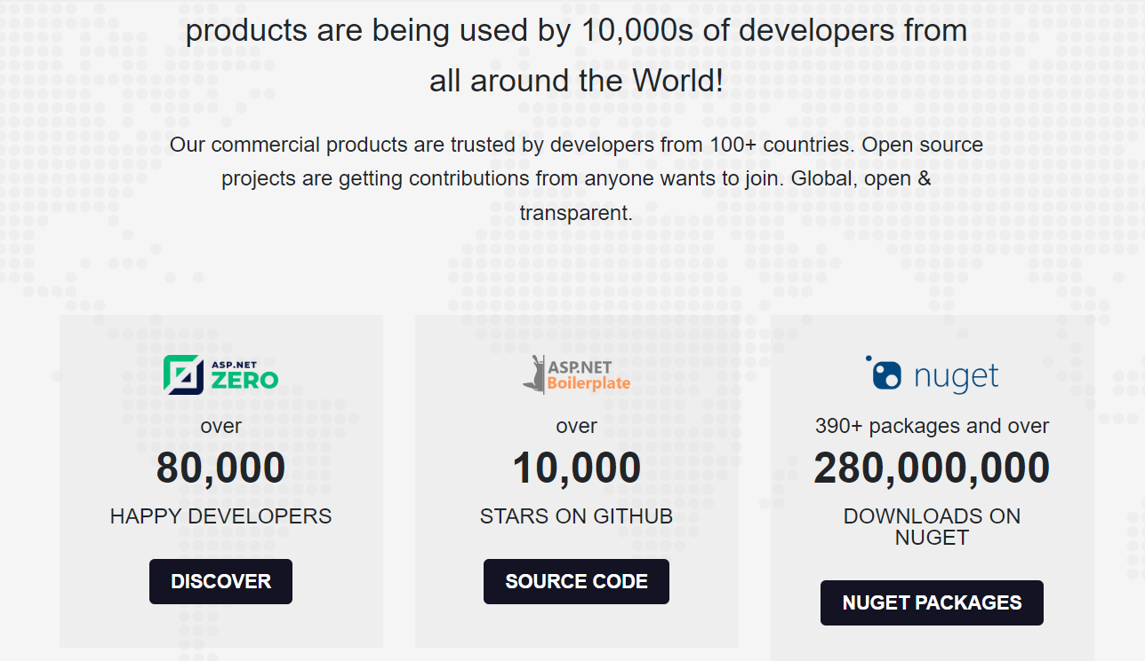

ASP.NET Boilerplate
About Volosoft - ABP Community

Slide 5
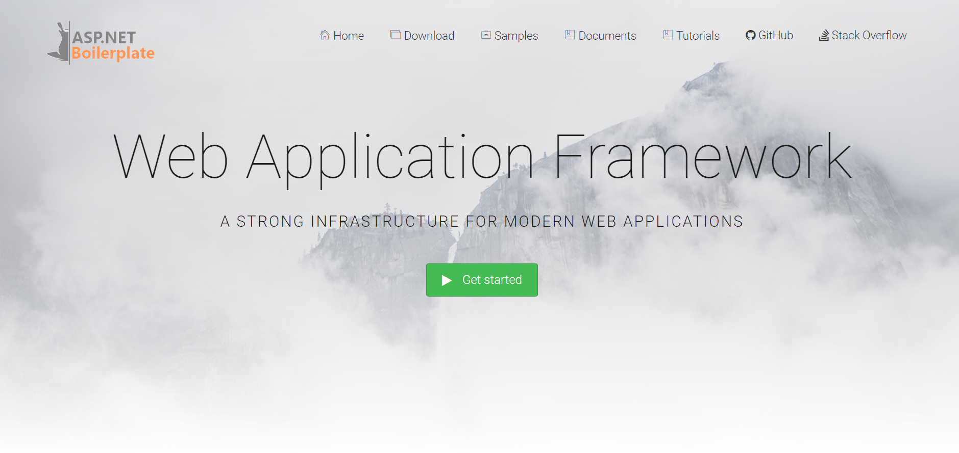
ABP Framework Introduction
Don't Repeat Yourself!
What is the ASP.NET Boilerplate
Getting Started
ASP.NET Boilerplate (ABP) is an open source
Well-documented application framework.
A strong architectural model based on Domain Driven Design.
https://aspnetboilerplate.com/Templates
Or

Slide 6
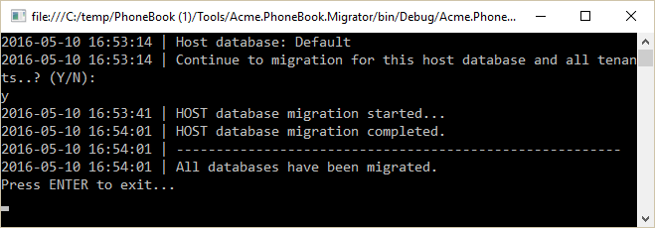
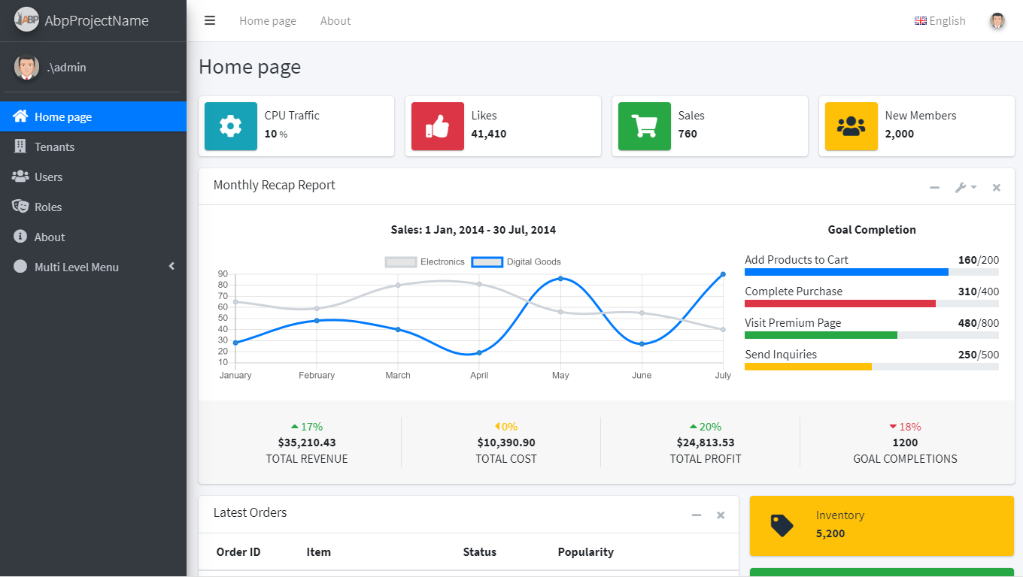
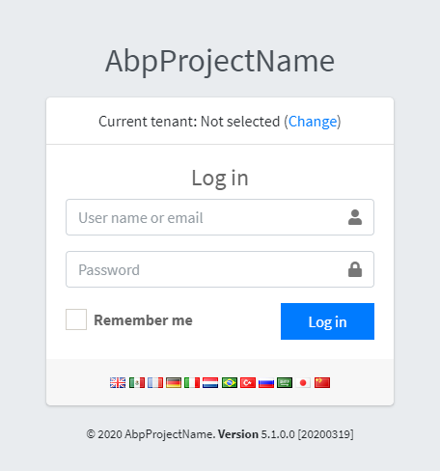
'Gét Gô'
Edit Config
Connection string.
Update app configs. (if have)
Run Migration
Select startup project
Run command: PM> update-database
Run the applicationk
Restore Client-Side Libraries with libman
Dotnet run or start on project

Slide 7
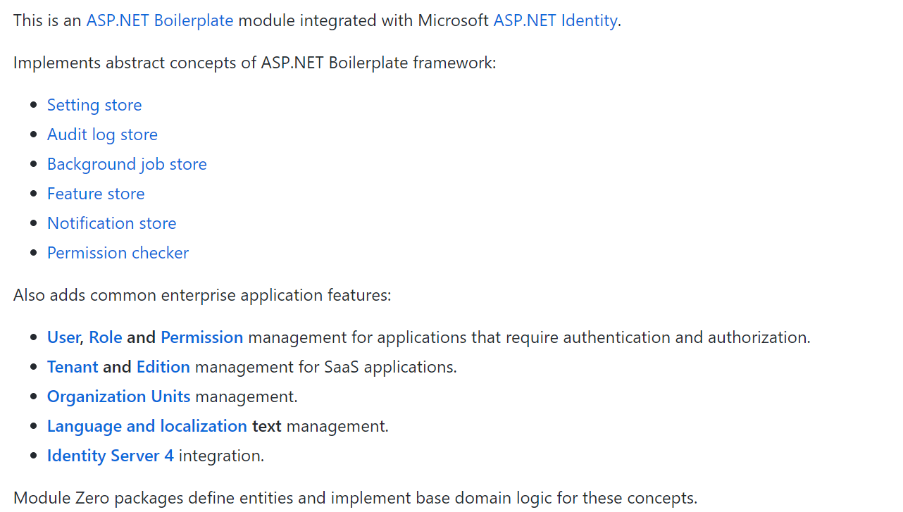
What is 'Module Zero'?

Slide 8
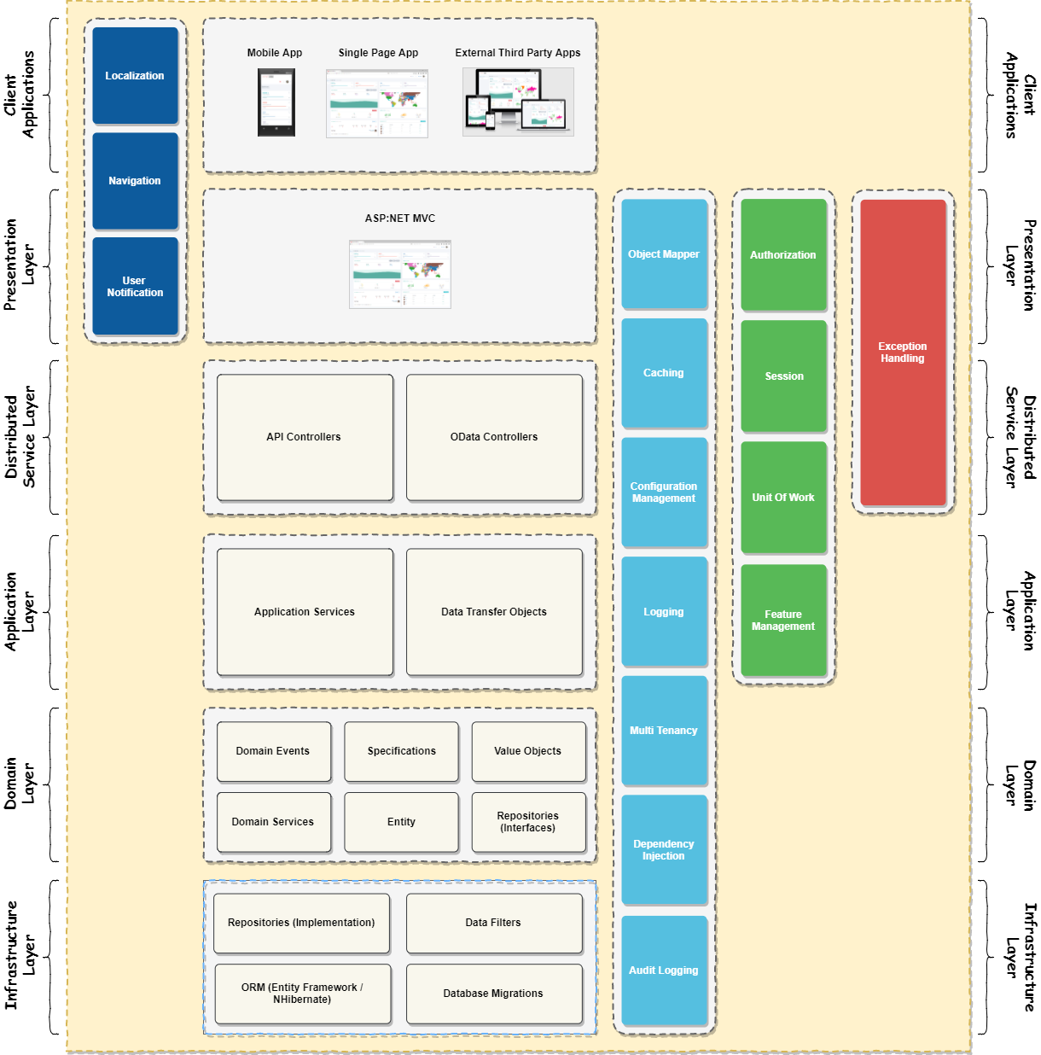
Layered Architecture Layered Architecture

Slide 9
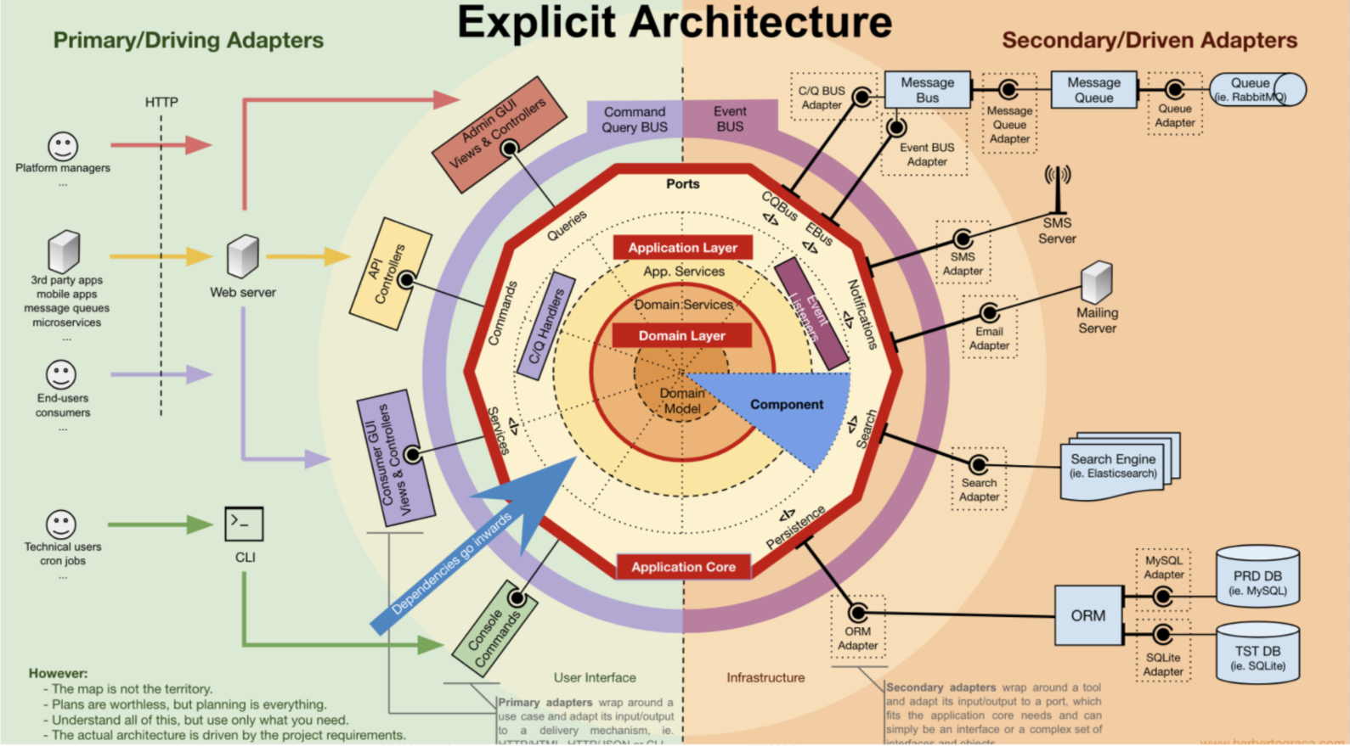
Explicit Architecture
- Domain-driven Design (a.k.a DDD)
- Command and Query Responsibility Segregation (a.k.a CQRS)
- Clean Architecture

Slide 10
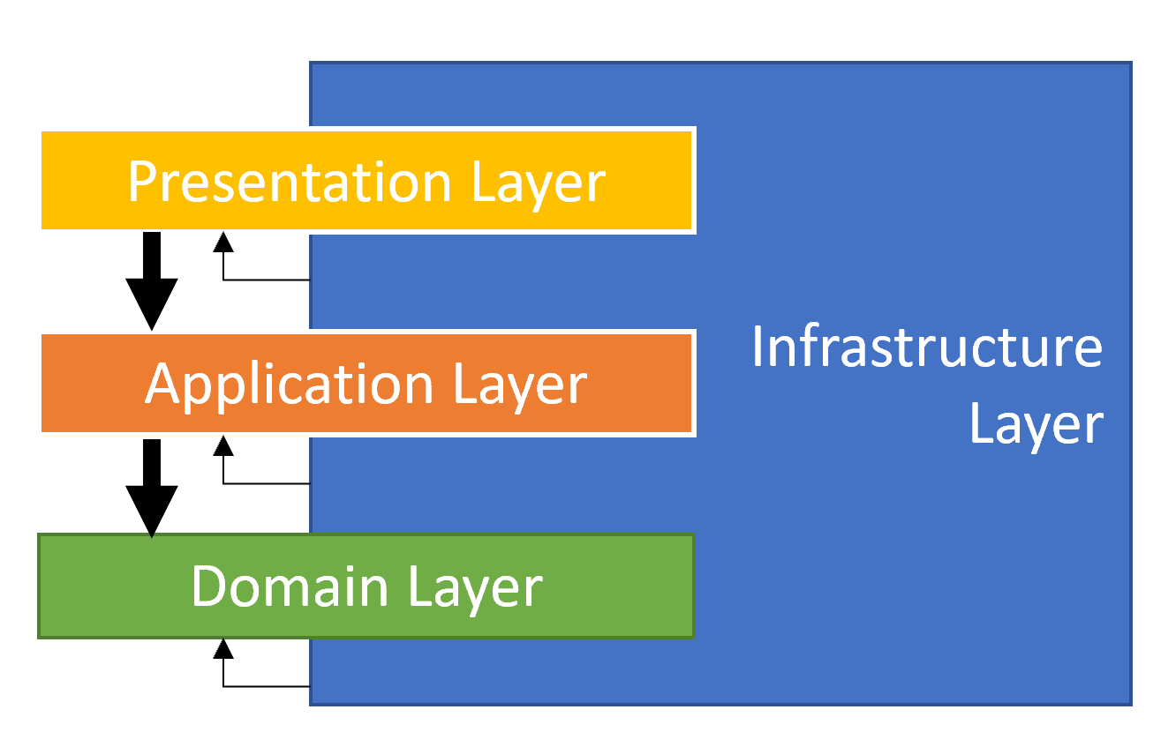
Explicit Architecture
Domain-driven Design

Slide 11
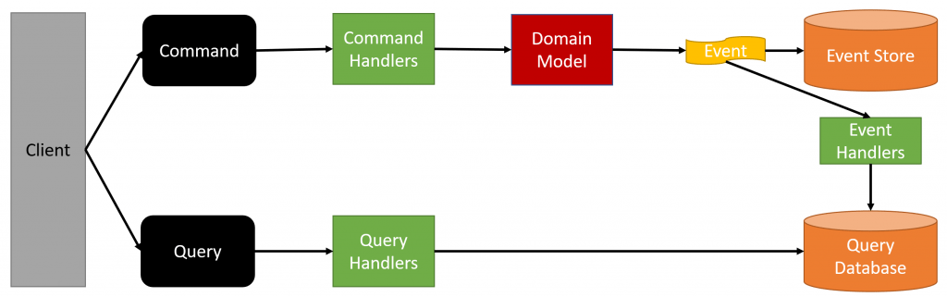
Explicit Architecture
CQRS

Slide 12
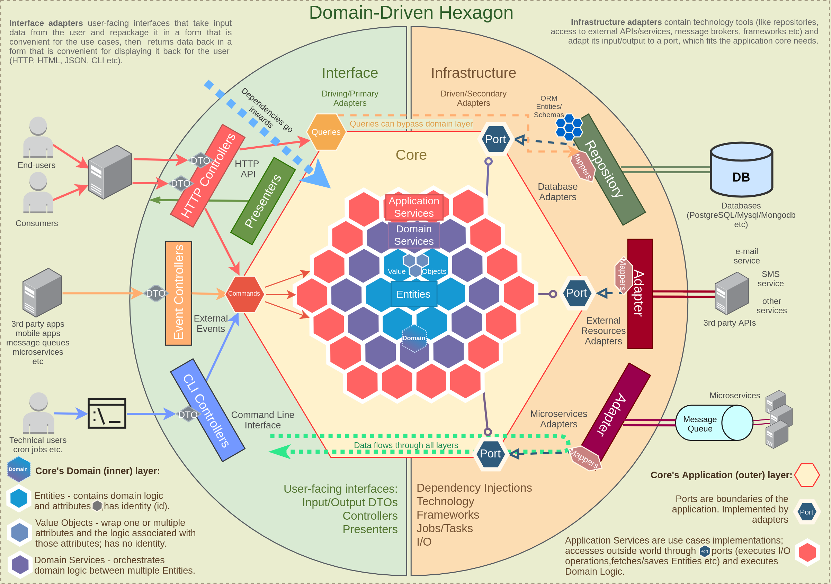
Explicit Architecture
Clean Architecture

Slide 13
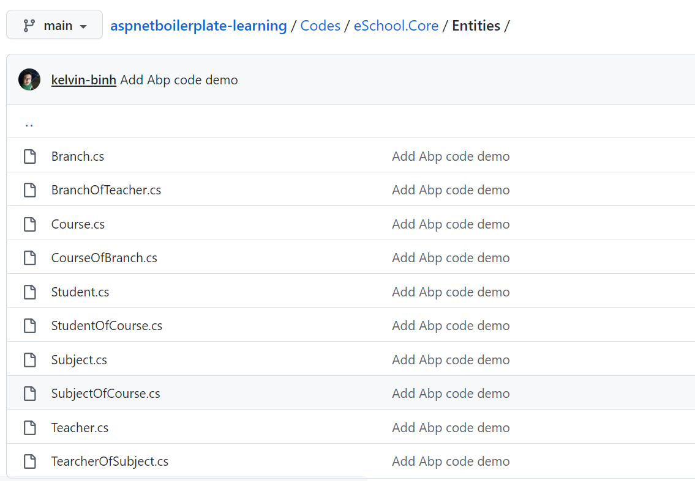
Demo Developing the Application
Creating Entities
The entity is part of the domain layer and add it into the .Core project.
Code demo

Slide 14
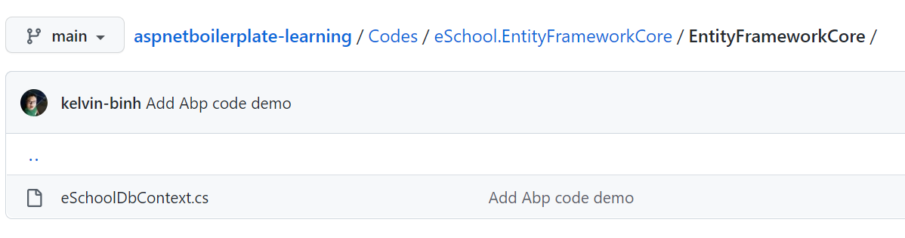
Demo Developing the Application
Adding the entities to DbContext
.EntityFrameworkCore project includes a pre-defined DbContext and should add the DbSet for the Entities into the DbContext.
Code demo
Creating the First Database Migration
Open the Package Manager Console from Visual Studio and run the Add-Migration command (Default project must be the .EntityFrameworkCore project)
Run command: PM> update-database

Slide 15
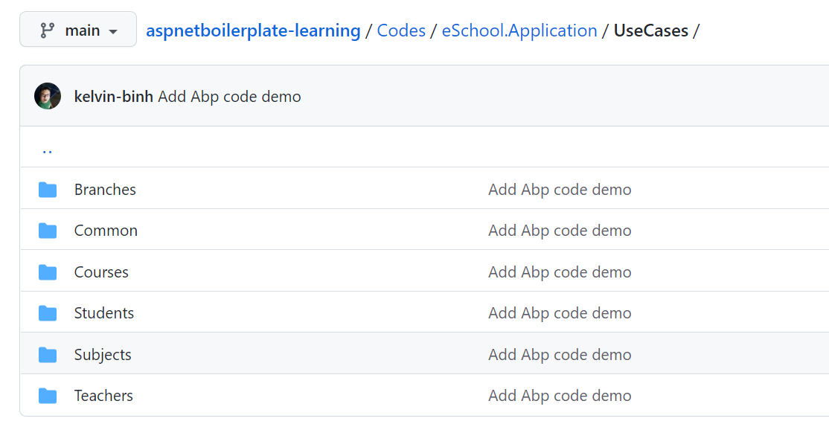
Demo Developing the Application
Create Application Service and Testing
Create AppService, into the .Application project to perform application logic
Code demo
Note: Application Services are used to expose domain logic to the presentation layer. An Application Service is called from presentation layer with a Data Transfer Object (DTO) as parameter (if needed), uses domain objects to perform some specific business logic and returns a DTO back to the presentation layer (if needed).

Slide 16
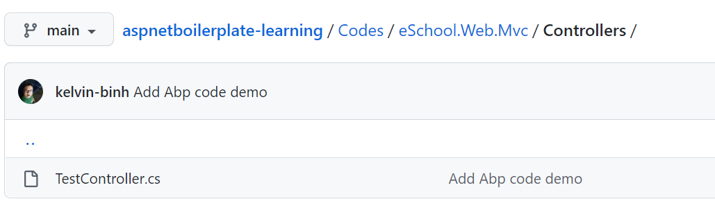
Demo Developing the Application
Integrate Application Service with web controller
Creating a new controller class in the .Web project
Code demo

Slide 17
To avoid when use ABP Framework
Whenever you want 100% control of your code and the libraries you are using (and want to know what you are doing).
For very complex web sites, when you need to adhere to certain REST standards for your web API or have some custom / special authentication / authorization needs. Of course, you can still achieve your objectives by customizing the framework, but this may be counterproductive. It’s better to start from scratch and build the web site by yourself.
Where high performance is a top priority. This is because ABP uses dynamic code generation for web API and JavaScript proxies.

Slide 18
References
https://aspnetboilerplate.com/Pages/Documents
https://github.com/aspnetboilerplate/aspnetboilerplate
https://aspnetboilerplate.com/Pages/Documents/Articles-Tutorials
https://domaindrivendesign.org/the-main-goal-of-domain-driven-design
https://github.com/gautema/CQRSlite
https://github.com/Sairyss/domain-driven-hexagon
https://stackoverflow.com/questions/tagged/aspnetboilerplate
https://www.objectivity.co.uk/blog/thoughts-asp-net-boilerplate

Slide 19
Thank You.

